Slide 1

Self-Budgeting Application Scrum Project Plan
Niranajaan Veeraraghavan Munuswamy – A20552057
Chaitanya Durgesh Nynavarapu-A20561894
Dresha Reddy Bommana – A20546970
Ashish Reddy Thumu-20560560

Slide 2
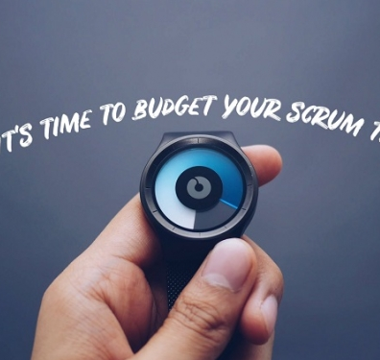
Introduction
This Self-Budgeting Application project aims to provide users with robust tools for managing personal finances through income and expense tracking, budget setting, and financial reporting. The transition to Scrum facilitates iterative development, user feedback, and adaptable planning.

Slide 3

Project Goals and Objectives
Primary Objectives:
Accurate tracking of income and expenses.
Budget goal setting and monitoring capabilities.
Generation of insightful financial reports.
Scrum enables adaptability for meeting user needs and continuous improvement.

Slide 4

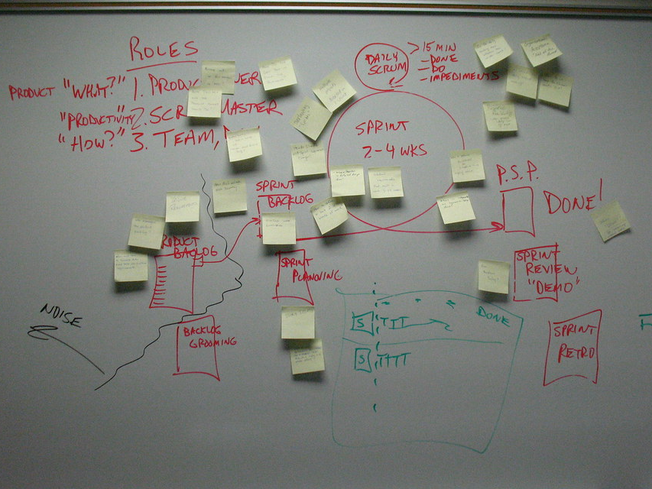
Scrum Framework Overview
Scrum provides an iterative approach, ideal for developing core budgeting features that require feedback-driven improvement. The flexibility of Scrum allows early delivery of functional budgeting increments and ongoing adjustments.

Slide 5

Roles and Responsibilities in Scrum
Product Owner: Manages budget-related priorities and user requirements.
Scrum Master: Facilitates sprint workflow and resolves blockers.
Development Team: Focused on secure data handling, accurate financial computations, and intuitive UI.
Additional Roles: Security Engineer, DevOps for production deployment.

Slide 6
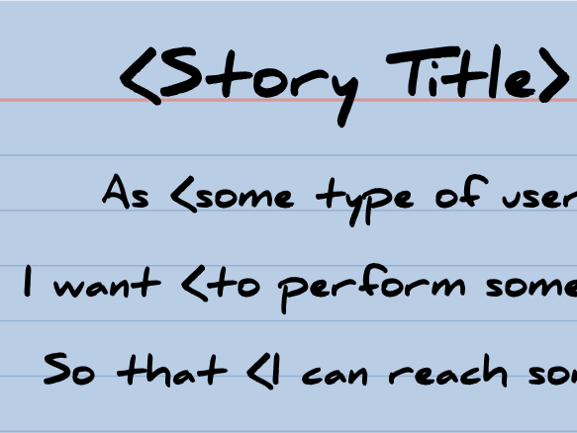
User Stories and Product Backlog
Key User Stories:
'As a user, I want to set daily, weekly, and monthly budgets to manage spending.'
'As a user, I want categorized expense tracking to understand my spending habits.'
'As a user, I want alerts when nearing my budget limits.'
Prioritized backlog items ensure user-centered feature delivery.

Slide 7
Detailed Sprint Breakdown - Sprints 1 & 2
Sprint 1: Requirements gathering, architecture design, and initial wireframes.
Tasks: Define user stories, prioritize backlog, design UI for income/expense tracking.
Sprint 2: Core functionality for tracking income and categorizing expenses.
Tasks: Build income tracking feature, set up backend data handling.

Slide 8
Detailed Sprint Breakdown - Sprints 3 & 4
Sprint 3: Budget setting, notifications for budget limits, and spending alerts.
Tasks: Develop notification module, link budgeting functions.
Sprint 4: Testing, feedback integration, final documentation.
Tasks: User Acceptance Testing (UAT), prepare for deployment.

Slide 9
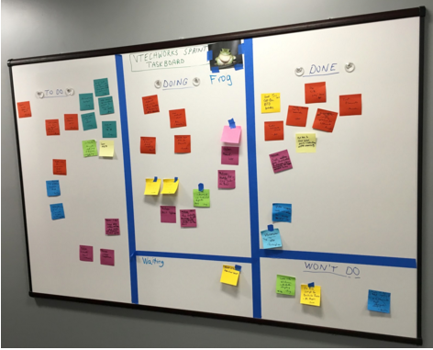
Sprint Workflow for Self-Budgeting App
Workflow tailored for budgeting features:
Product Backlog prioritization based on budgeting functionalities.
Sprint Planning and task estimation.
Daily stand-ups and sprint review to refine budgeting features.
This workflow supports iterative progress on core financial features.

Slide 10

Task Estimation and Burndown Chart
Each task is estimated for effort (hours/days), focusing on income tracking accuracy and budgeting limits.
Burndown chart visualizes completion of budgeting and notification features over sprint duration.

Slide 11
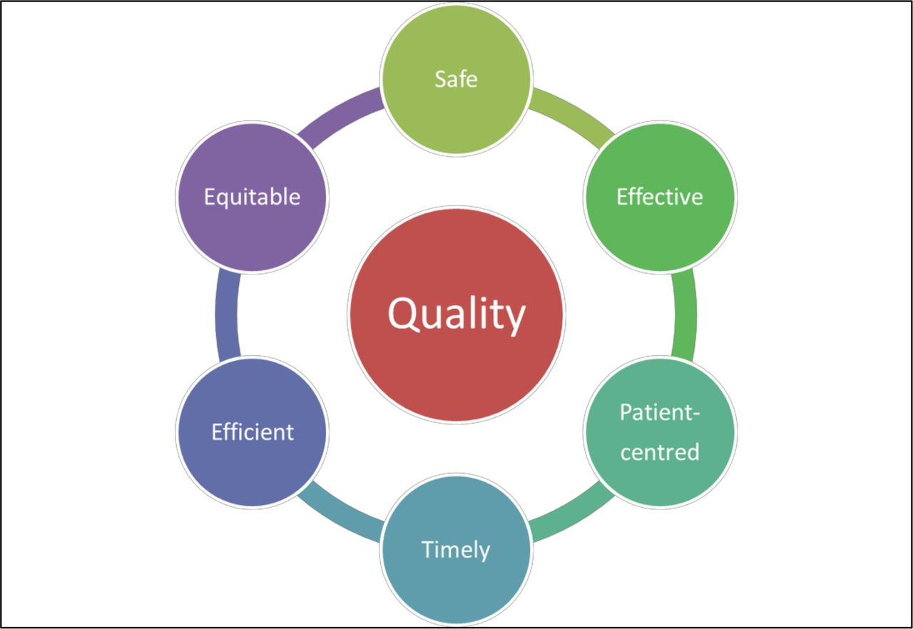
Quality Assurance for Financial Accuracy
Unit Testing for budgeting calculations.
Integration Testing for expense tracking.
User Acceptance Testing for real-time budget data accuracy and responsiveness.

Slide 12
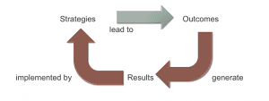
Deployment and Maintenance Strategy
DevOps practices for deploying in a live environment, with continuous monitoring for budgeting app feedback.
Regular maintenance to ensure secure data handling and prompt user support for feature enhancements.

Slide 13

Documentation and Reporting
Comprehensive documentation:
User Manuals for income/expense tracking and budgeting setup.
Financial data reporting and API documentation.
Reports on Scrum effectiveness specific to budgeting accuracy improvements.

Slide 14
Conclusion and Expected Outcomes
Scrum benefits: adaptability for feature growth, incremental improvements for budgeting accuracy.
Expected outcomes include reduced budgeting errors, improved user feedback handling, and financial scalability.

